Slide 1

Time Series Final Project
Air Pollution Prediction
Team Member:
Flora Huang, Qiansheng Zhou, Zhangchi Liu, Kaichong Zhang, Michael Wu

Slide 2
Agenda
1 | Introduction
2 | Data Preparation
3 | Experimental results and Analysis
4 | Model Selection
5 | Conclusion and Future work
6 | Appendix

Slide 3
Executive Summary
Overview
Air Pollution
Air pollution is a major global environmental risk to our health and food security. It is estimated to cause about 3.7 million premature deaths worldwide and destroys enough crops to feed millions of people every year.
Air pollution can affect lung development and is implicated in the development of emphysema, asthma, and other respiratory diseases, such as chronic obstructive pulmonary disease (COPD)
ESG
ESG topic recently raised attention from various global companies and nations. People are talking more about environment and sustainable development. As a one of the major pollution in the world, air pollution will be an inevitable problem.
Problem Related
Categories of Air Pollution
There are different categories(PM 2.5, SO2, NO2 etc.) of air pollutions in our problem and prediction. As the region we are researching, PM 2.5 is one of the major problem we would like to focus in China.
Prediction
PM 2.5 will lead short-term health effects such as eye, nose, throat and lung irritation, coughing, sneezing, runny nose and shortness of breath. This will affect schools, companies, and outdoor activities running.
Predicting PM 2.5 ahead of time will help governments and companies to make reasonable procedures to protect people’s health and reduce economic loss.
Project Overview
Data
Our data comes from UCI data library, and it covers 12 regions from Beijing.
Tool
R is the main tool to process and build model of our project.
1. niehs; 2. UCI

Slide 4
Business Problem
The annual average concentration of fine particulate matter (PM2.5) across China was 57 micrograms per meter cubed in 2017, nearly six times what the World Health Organization deems to be acceptable limits. Poor outdoor air quality results in over 1 million deaths across China each year.
Problem
The causes of Beijing's widespread air pollution can be attributed to several factors: an enormous economic boom, a surge in the number of motorized vehicles, population growth, output from manufacturing, and natural reasons which include the city's surrounding topography and seasonal weather.
Reasons
Select related factors from 12 features and choose PM 2.5 as main problem
Use Exponential Smoothing, ARIMA, Naïve, Regression, and Regression with ARMA errors as our models to predict PM 2.5 for 3 months
Use Cross - validation to increase performance of our model
Methodology and Data
Government could use the prediction to arrange public events, public transportations and related factory running policy
Company could use the prediction to distribute remote or in-person work events
School could use the prediction to allocate students outdoor events
Patients could use the prediction to decide their drug and treatment steps
Business Use
Case
1. Ohiostate pressbook
Notes:
Set Your Business
Objectives & KPIs
Business
Measurement Plan
This final step dives into HOW to track each meter.

Slide 5
Data Preparation

Slide 6
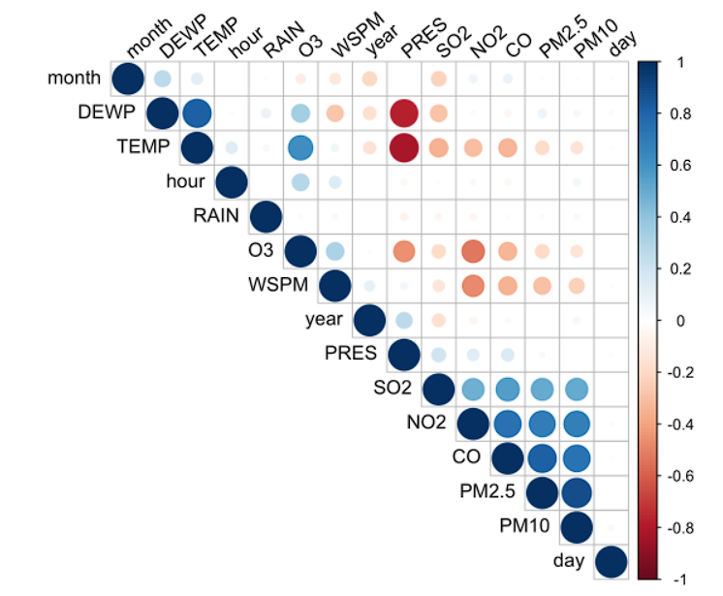
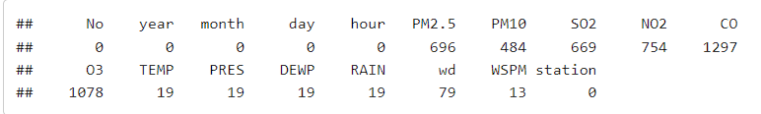
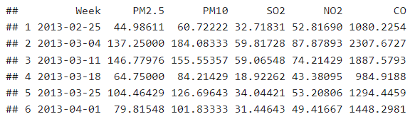
Data Processing
1
Data Overview
3
Feature Engineering
Combine day, month, and year to one column (Date)
Select features with strong correlation with PM2.5
Get weekly average of relevant features
Data Size | The dataset consists of 35,064 entries
Data Attribute | 18 attributes: 6 main air pollutants and 6 relevant meteorological variables
Data Detail | The dataset was formed but still composed with missing value
Data Window | March 1st, 2013 - February 28th, 2017
2
Check Missing Value
Correlation Map
Average Weekly Data
Notes:
Set Your Business
Objectives & KPIs
Business
Measurement Plan
This final step dives into HOW to track each meter.

Slide 7
Experimental Results and Analysis

Slide 8
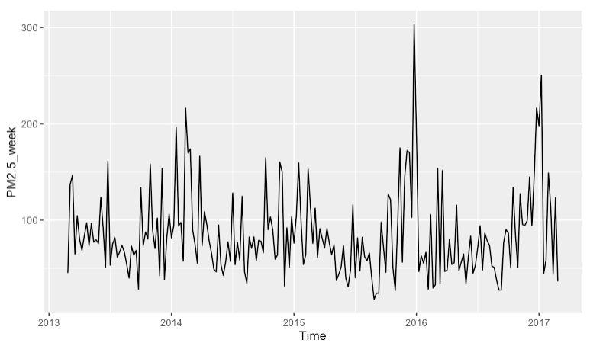
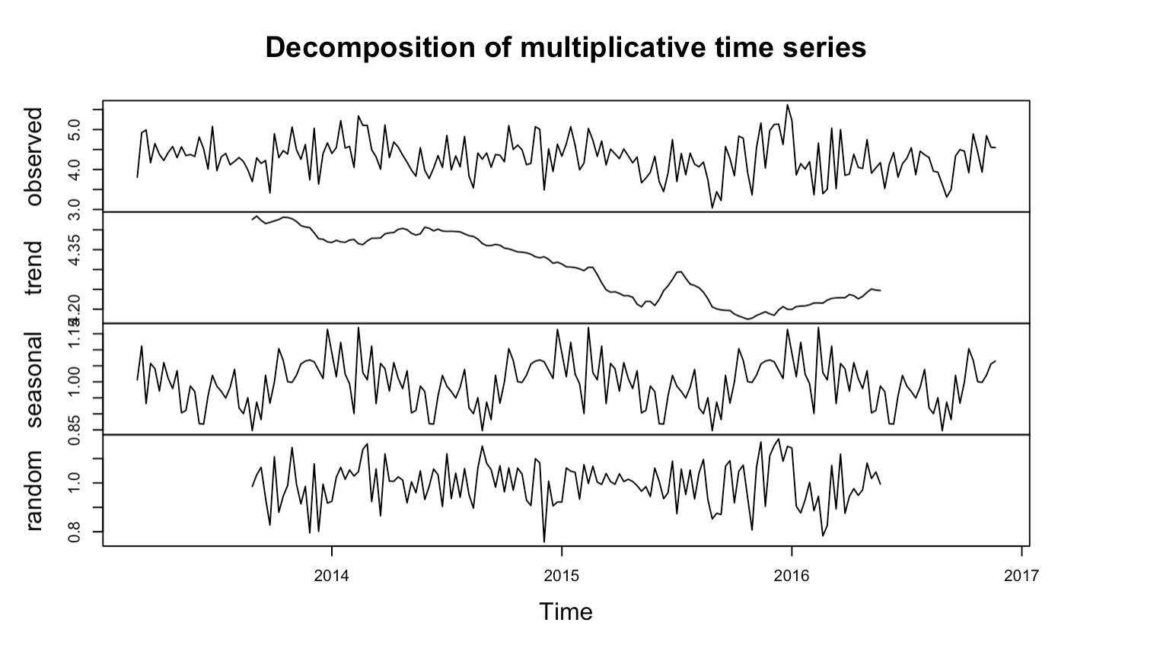
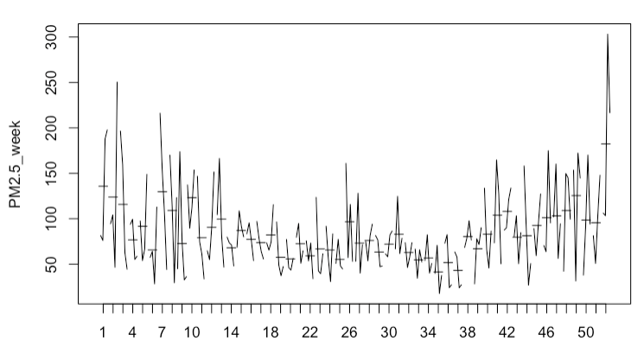
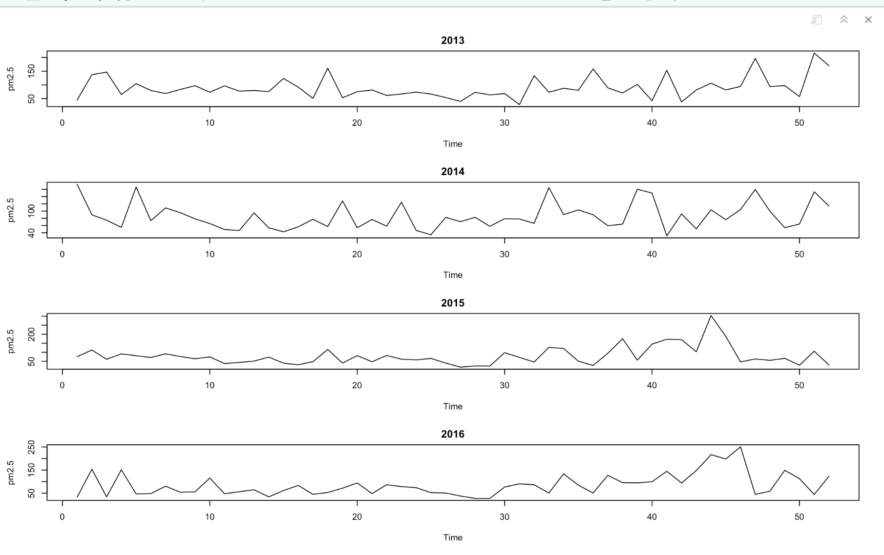
PM2.5 Exploratory
Seasonal Pattern Exists – Numbers are lower in summer and higher in winter
Slightly Downward Trend
Autoplot of Weekly PM2.5
Seasonal Decomposition
Weekplot(PM2.5)
PM2.5 by Year
Notes:
Set Your Business
Objectives & KPIs
Business
Measurement Plan
This final step dives into HOW to track each meter.

Slide 9
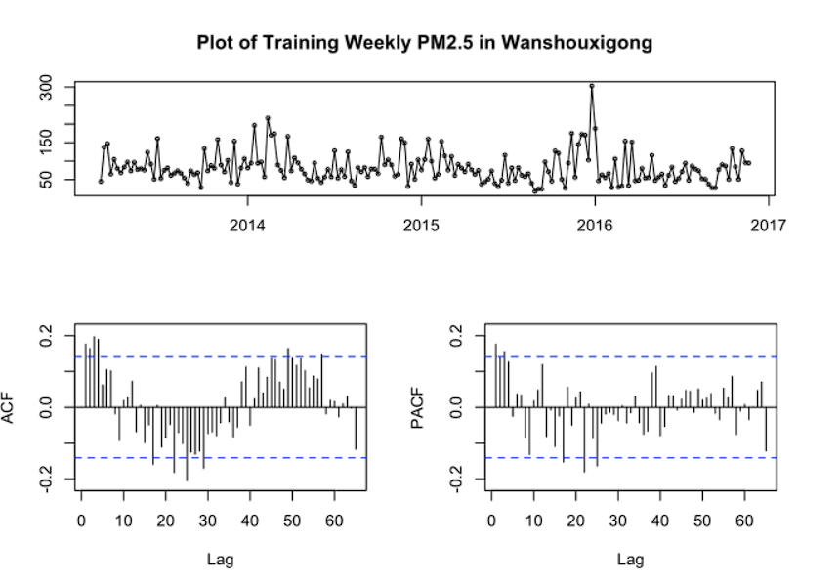
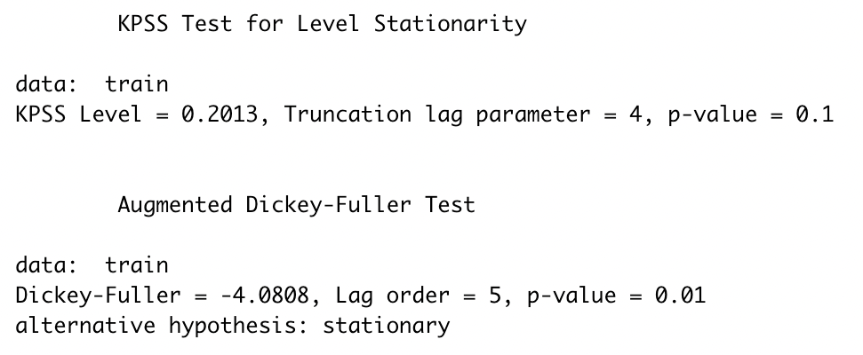
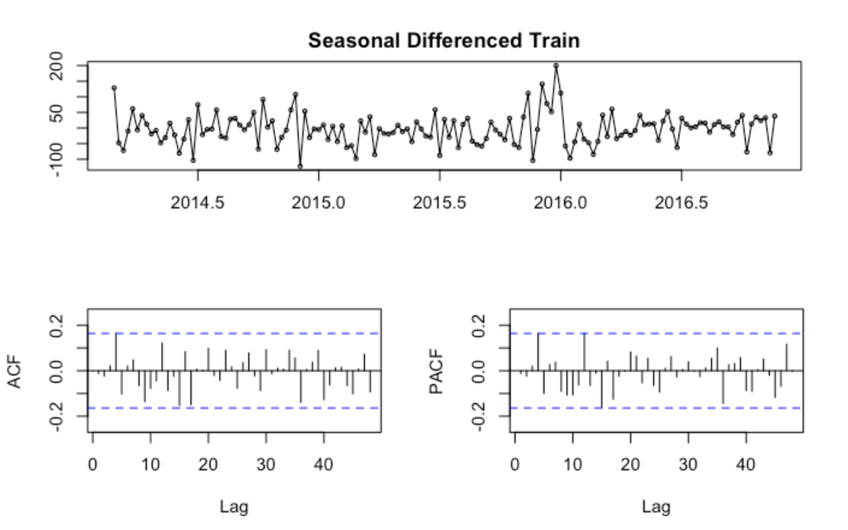
Data Transformation (1/2)
We split PM2.5 data into a training dataset (2013/3/1 – 2016/12/31) and a test dataset (2017/1/1 – 2017/2/29)
Observations and findings:
ACF plot decreases quickly to zero
KPSS test shows p-value (0.1) is larger than 0.05
ADF test shows p-value (0.01) is less than 0.05
All values of ACF are within bound after one level of seasonal differencing
Plot Training Data
KPSS & ADF Test
Seasonal Differenced ACF
Notes:
Set Your Business
Objectives & KPIs
Business
Measurement Plan
This final step dives into HOW to track each meter.

Slide 10
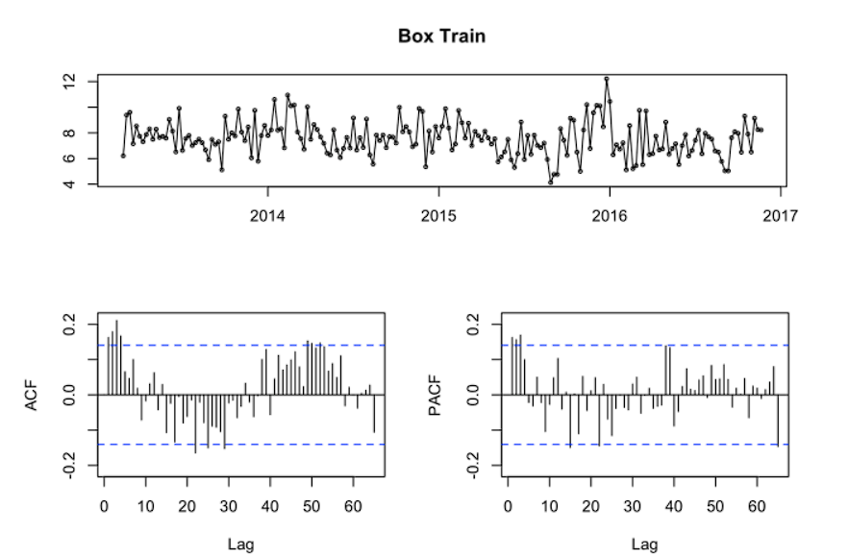
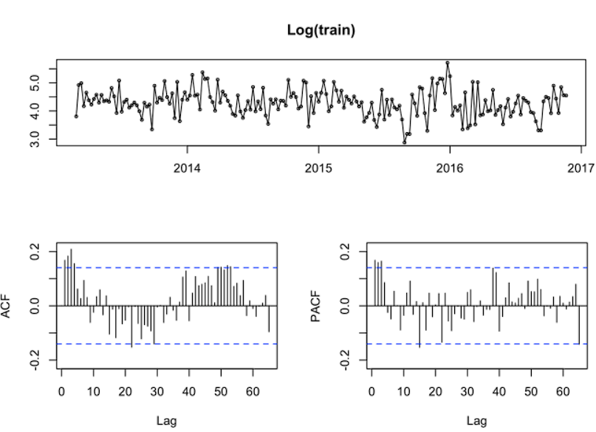
Data Transformation (2/2)
Log transformation is preferred since the variance looks stabilized and there is more values in bound in the ACF plot。
Box – Cox Transformed Train Data (λ = 0.93)
Log Transformed Train Data
Notes:
Set Your Business
Objectives & KPIs
Business
Measurement Plan
This final step dives into HOW to track each meter.

Slide 11
Model Selection

Slide 12
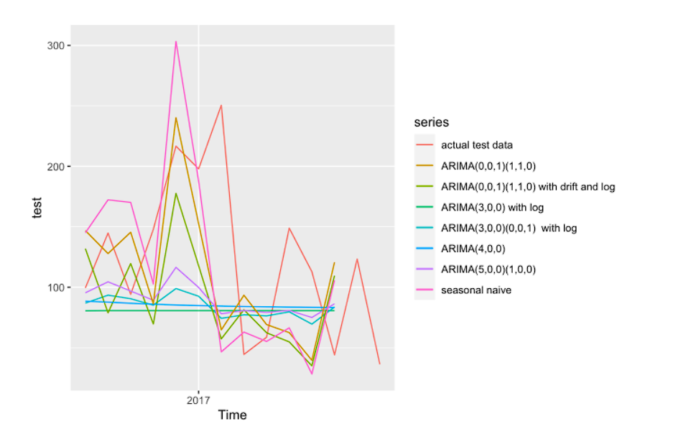
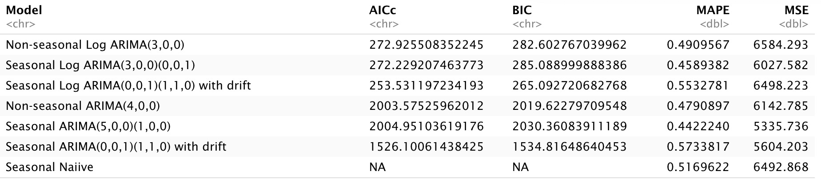
Model – Arima and Naïve (1/3)
We build 7 models in total:
Arima models/Seasonal Arima models/ Seasonal Arima models with D = 1/Seasonal Naïve model
Log transformed data/original data
The models with D = 1 look the most similar to the test data
The models without seasonal pattern are basically a straight line
The models on log transformed data have much smaller AICc and BIC
We choose 3 models to have further analysis in cross validation
Seasonal Arima(5,0,0)(1,0,0) has the smallest MAPE and MSE, but it has large AICc and BIC
Seasonal Log Arima(3,0,0)(0,0,1) has the second-best performance with low AICc and BIC
Seasonal Log Arima(0,0,1)(1,1,0) with drift has seasonal difference, and low AICc and BIC
x
x
Arima & Naïve Test result
Performance and precision
Notes:
Set Your Business
Objectives & KPIs
Business
Measurement Plan
This final step dives into HOW to track each meter.

Slide 13
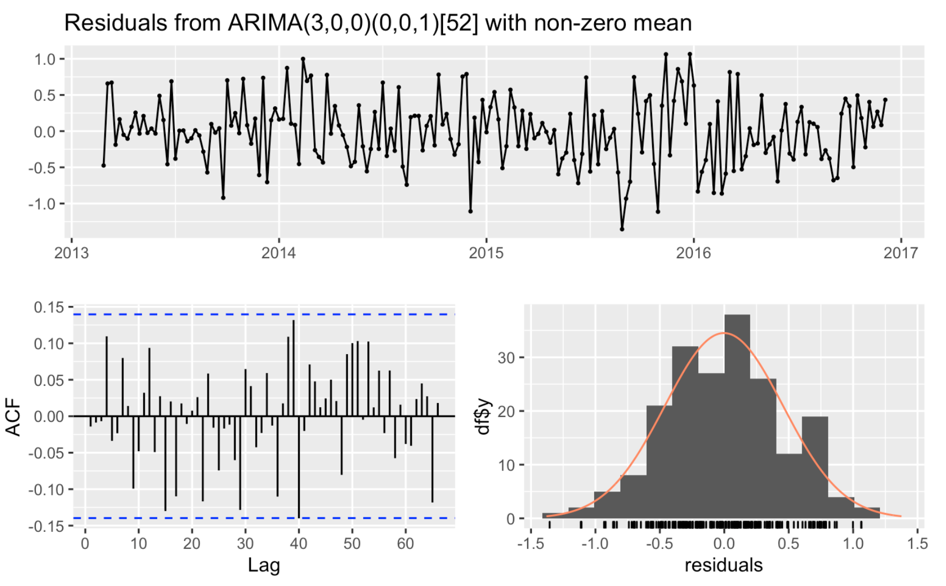
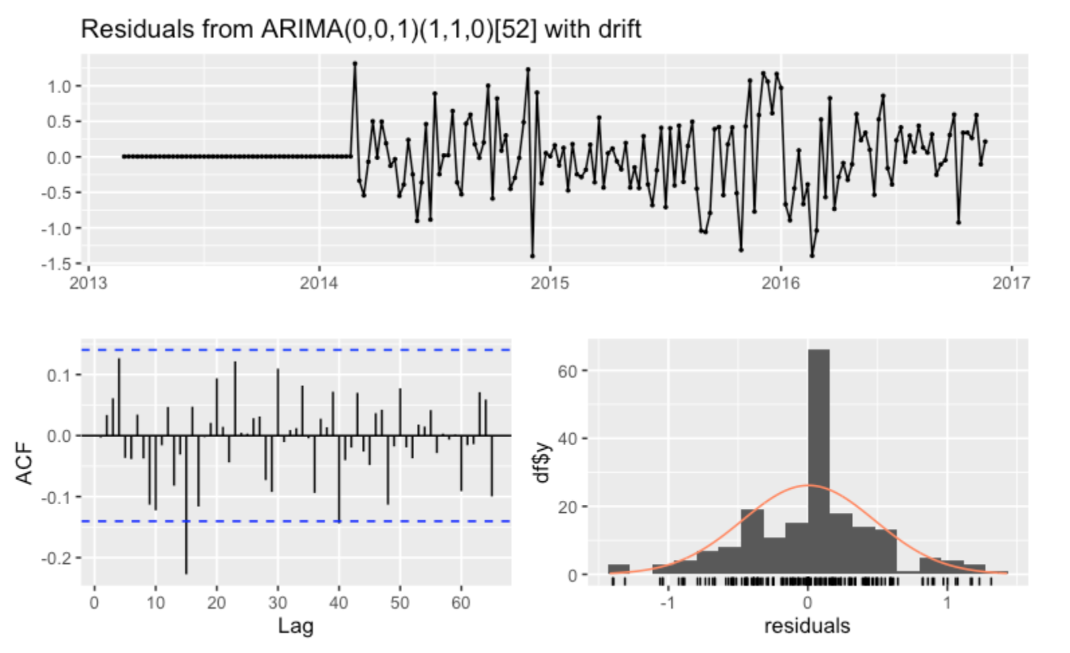
Model – Arima and Naïve (1/3) Cont.
Arima Prediction Residual
Only ARIMA(0,0,1)(1,1,0) with drift’s ACF has one value out of bound.
ARIMA(1,1,1)(0,0,1)’s residual is approximately a normal distribution.
Residuals from Seasonal Log Arima(3,0,0)(0,0,1)
Residuals from Seasonal Log Arima(0,0,1)(1,1,0) with Drift

Slide 14
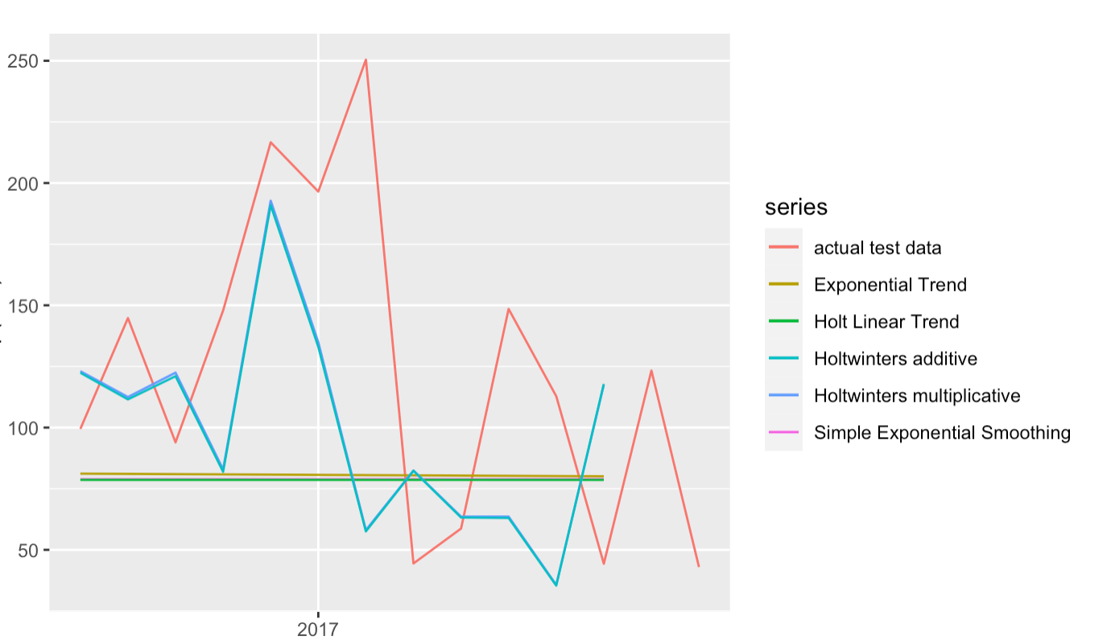
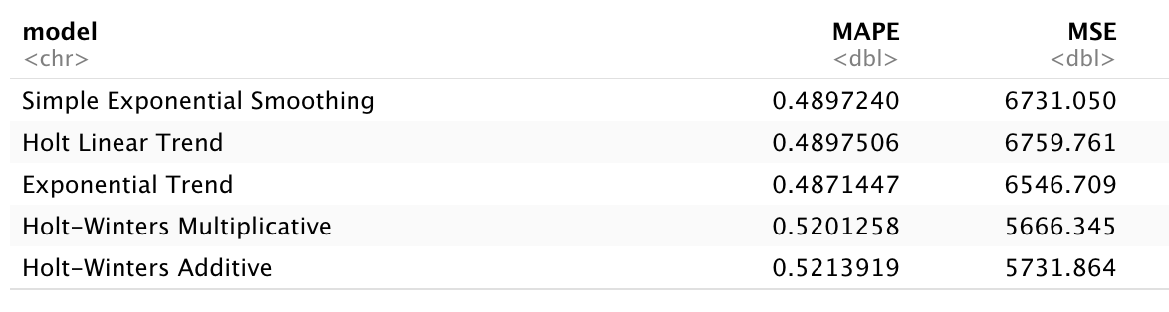
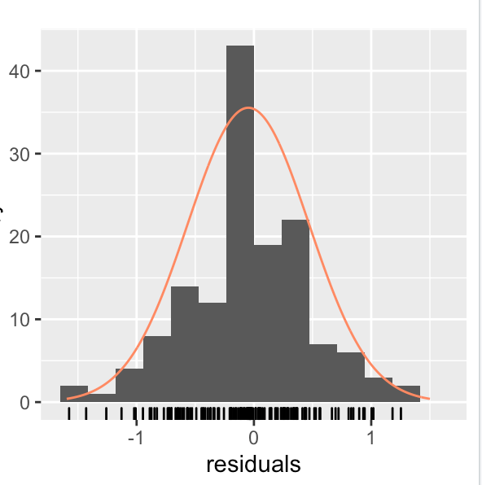
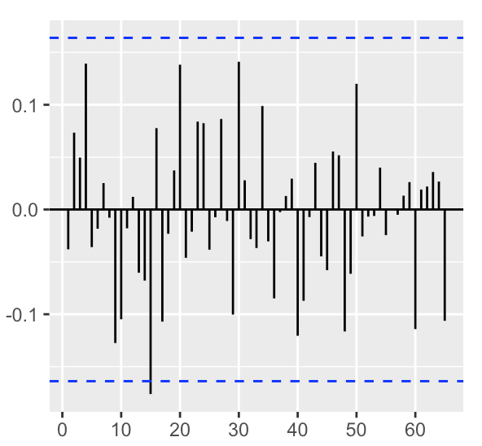
Model – Exponential Smoothing(2/3)
We built 5 models in total:
Simple Exponential Smoothing/Holt Linear Trend/Exponential Trend/Holt-Winters Additive/Holt-Winters Multiplicative
Log-transformed data
Downward trend & seasonality lead to unmet assumptions for 3 out of 5 models:
Simple Exponential Smoothing assumes no trend, no seasonality
Holt Linear Trend & Exponential Trend assume no seasonality
We choose Holt-Winters Multiplicative as our best exponential smoothing model
Exponential Smoothing Prediction
Performance and Precision
Notes:
Set Your Business
Objectives & KPIs
Business
Measurement Plan
This final step dives into HOW to track each meter.

Slide 15
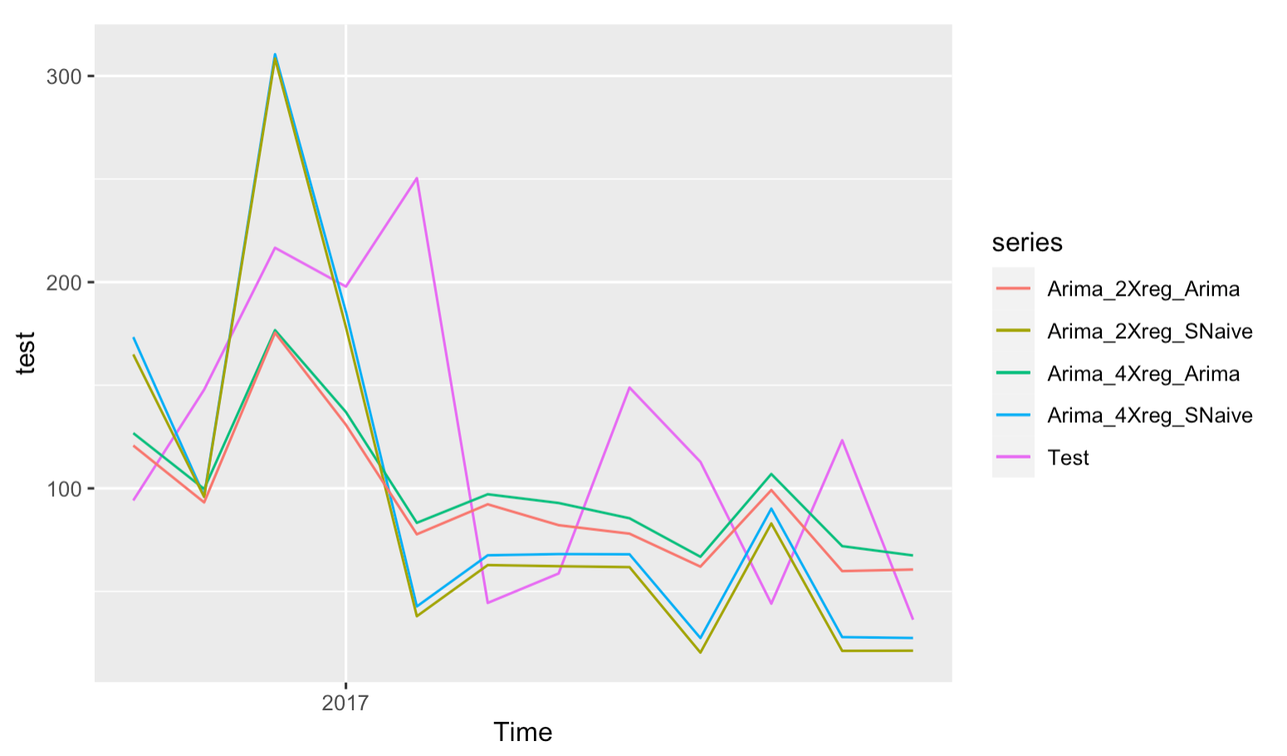
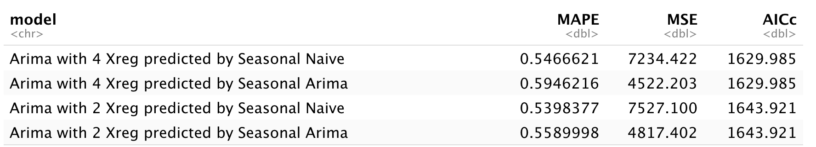
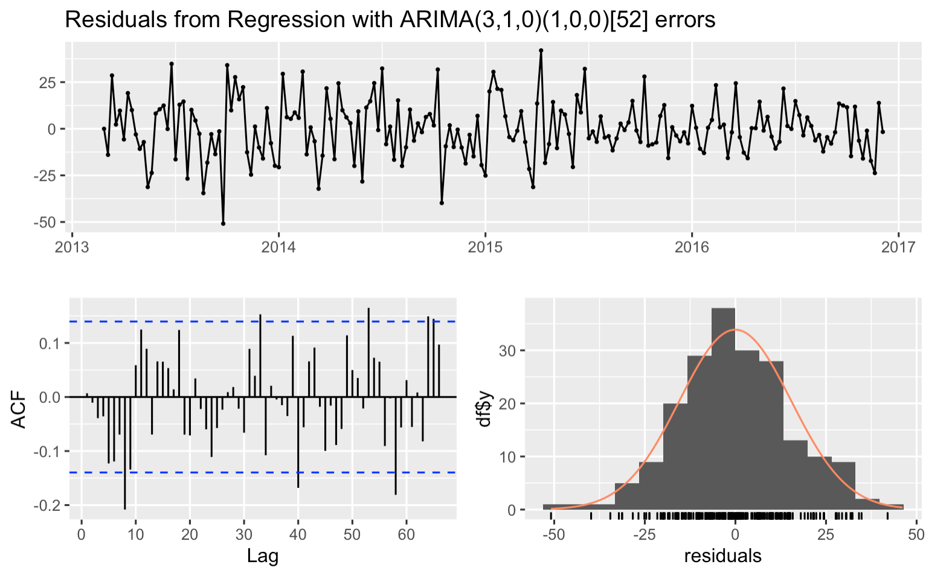
Model – Regression with ARMA errors(3/3)
The model is built as followings:
Linear and reduced linear regression with only significant variables are fitted.
Arima is then applied to the regression residuals.
Residuals are checked
Seasonal Naïve and Arima are used to predict the explanatory variables.
The final model is the Arima(2,1,3)(1,0,0) on the regression error of PM2.5 ~ PM10 + CO based on
MSE
AICc
Regression with ARMA errors result
Performance and precision
Notes:
Set Your Business
Objectives & KPIs
Business
Measurement Plan
This final step dives into HOW to track each meter.

Slide 16
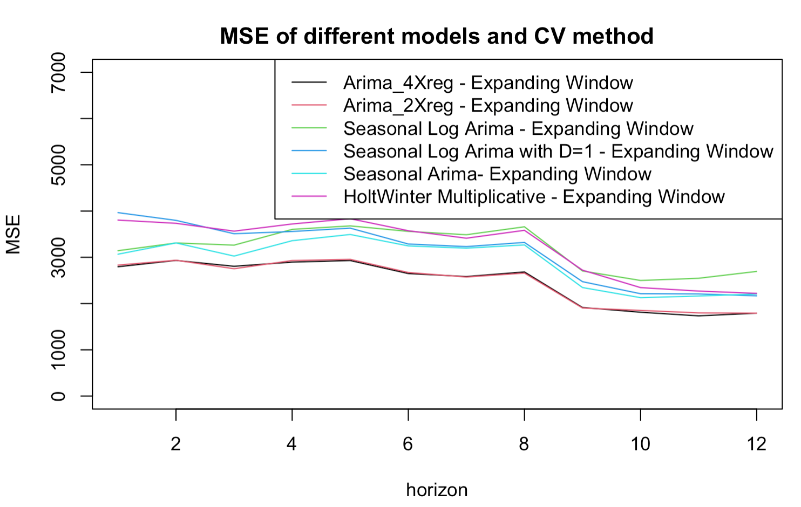
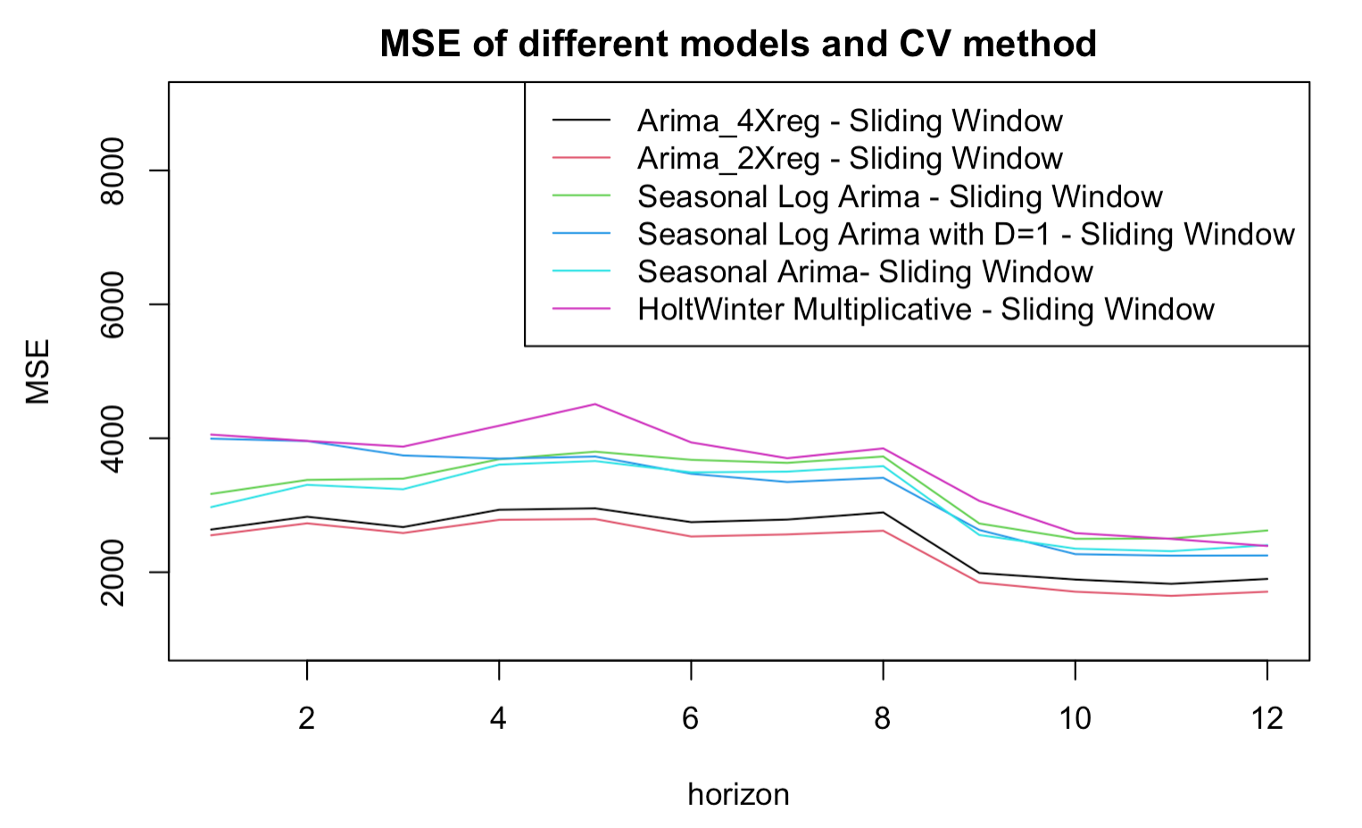
Cross Validation (1/2)
In order to provide a much more robust estimation of how the chosen modeling method and parameters will perform in practice, we apply cross validation on 6 selected models and calculate their MSE and AICc for expanding window and sliding window as another way to validate our results:
For both expanding window and sliding window, Arima with 2 Xreg and Arima with 4 Xreg predicted by Seasonal Arima have the lowest MSE and the HoltWinter Multiplicative has the highest.
Three Seasonal Arima models have similar performance.
AIMRA models with different numbers of predictors have similar performance.
Expanding MSE
Sliding MSE

Slide 17
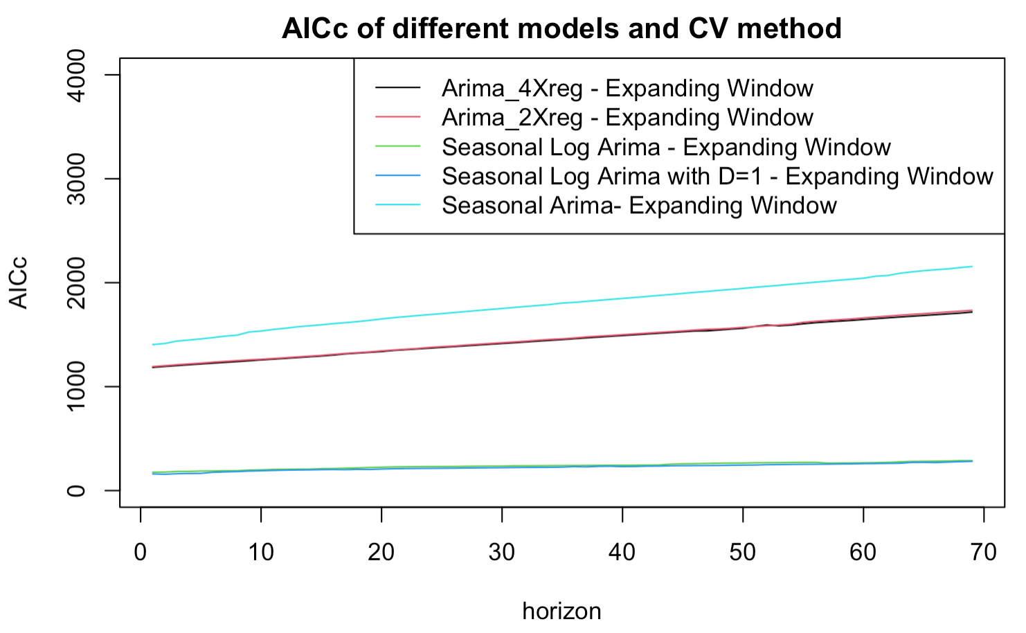
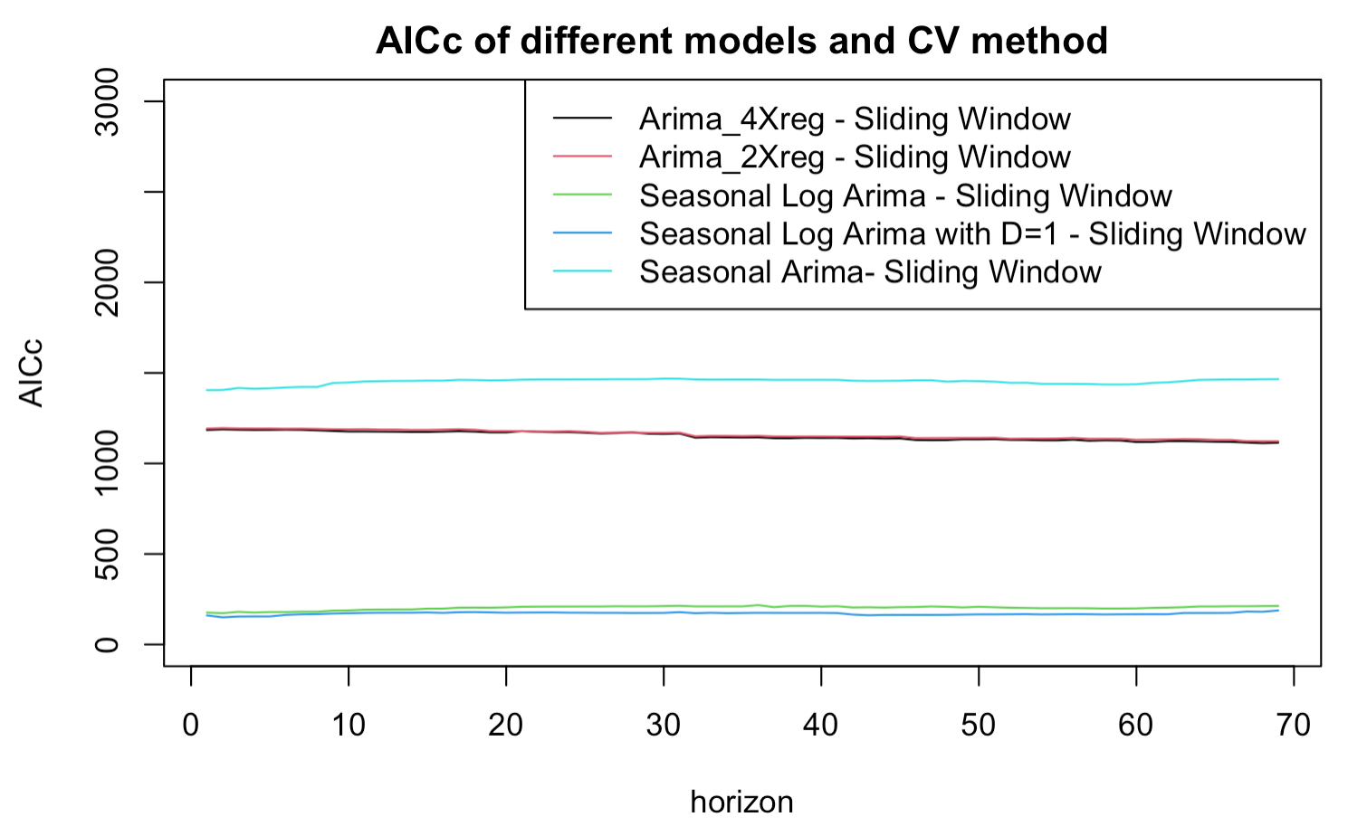
Cross Validation (2/2)
For both expanding window and sliding window, Seasonal Log Arima and Seasonal Log Arima with D=1 have much lower AICc compares to other models, which may caused by the reason that only those two models are performed on log transformed data.
AIMRA models with different numbers of predictors have similar performance.
Expanding AICc
Sliding AICc

Slide 18
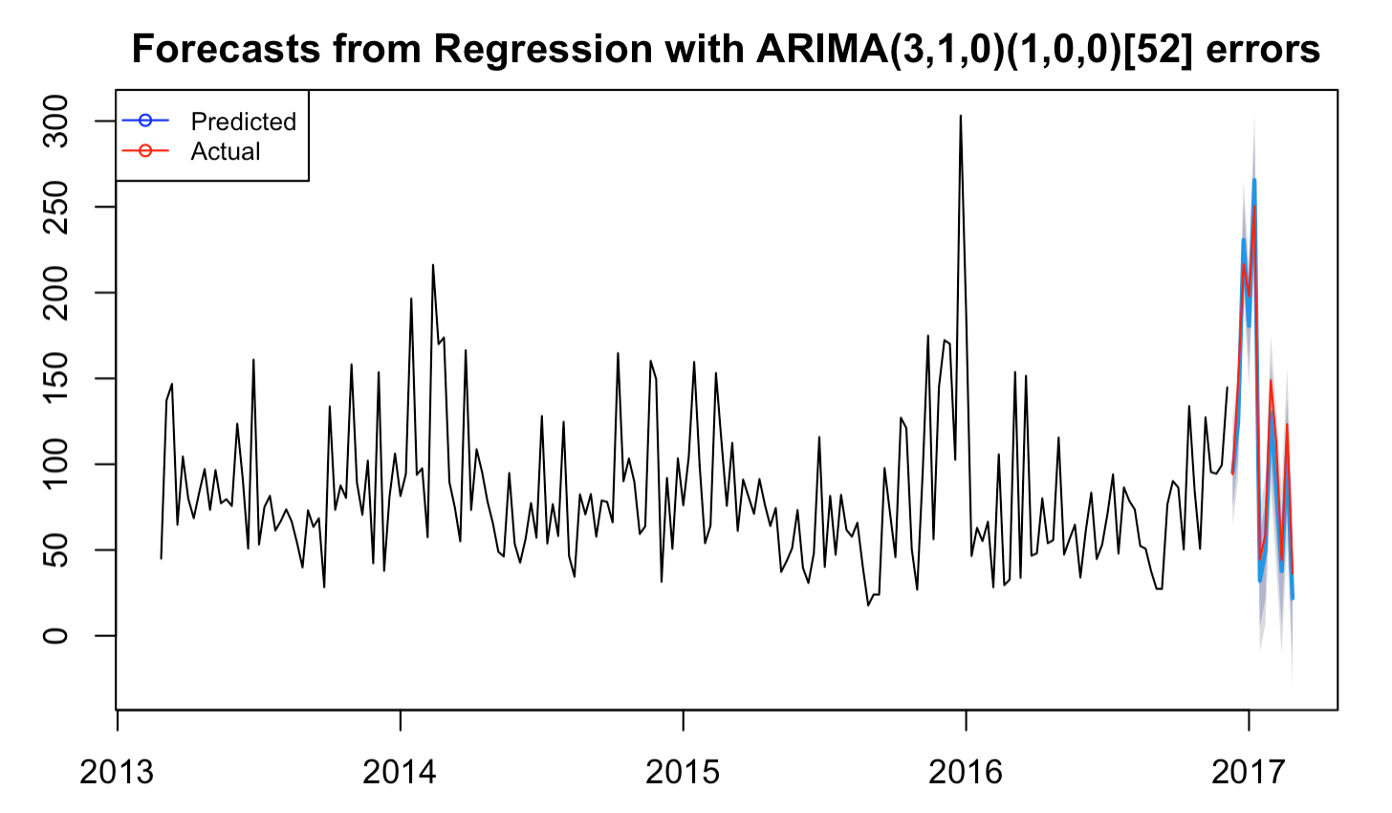

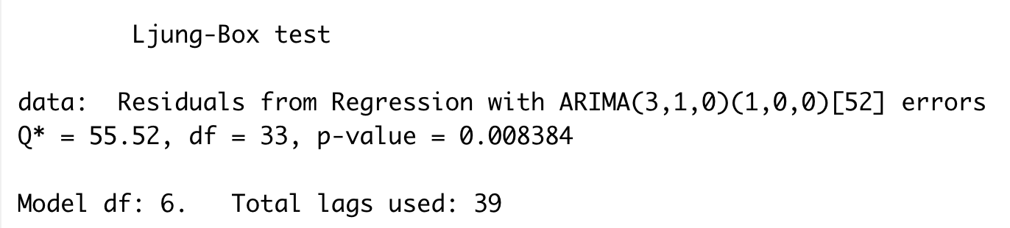
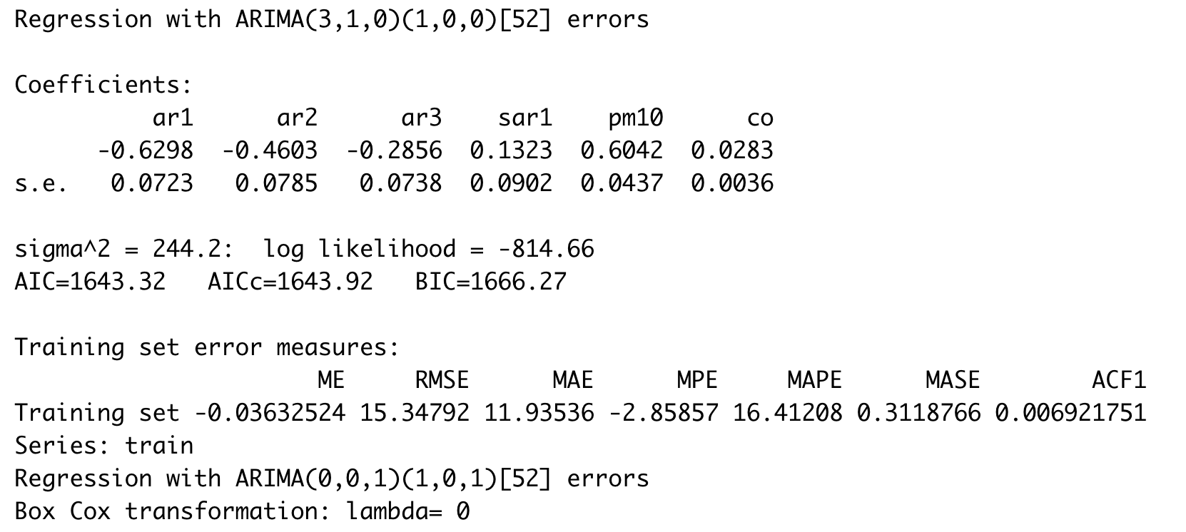
Final Model
Comparison between actual and forecast
Residuals from Regression
Check Stationary
Model Performance

Slide 19
Conclusion and Future Work

Slide 20
Conclusions
Our theory
Business Value
Precision is the main consideration. We think the prediction will affect people’s business and daily activities.
1
Arima with 2 Xreg and with 4 Xreg have the lowest MSE in on both expanding and sliding window, while Arima with 2 Xreg is simpler and more explainable as it has fewer variables.
Although Arima with 2 Xreg have larger AICc and BIC than Seasonal Arima models. We think it is acceptable because those models are performed on log transformed data, which may increase the data variance and reduces the penalty added by AICc.
As for the purpose of our model, we think that accuracy is the most important consideration for business implementation, we thus choose the model based more on MSE and MAPE instead of AICc and BIC.
Our models are mainly designed for governments or big enterprises. Therefore, we assume the customers at lease have some purchase abilities since the AICc and BIC are relatively high.
2
Environment protection organization could use our result to promote related policy and publicize procedures in certain situations.
3
Therefore, we select Arima with 2 Xreg predicted by Seasonal Arima as our final model.
Notes:
Cross – valialidation 通过数据选择出来的，综合考量，AICC也考虑,MSE
Business
Measurement Plan
This final step dives into HOW to track each meter.
Precesion; AIC和BIC不是最低的，不是最简单的，cost有一点；

Slide 21

Recommendations
Data Overview Problem:
Tips 1 – Irregular Peaks
The original data has two peaks in late 2015 and 2016, which may influence our model. There may be some underlying reasons for those two peaks.
Tips 2 – Data Quality
The data is somewhat outdated and contains missing values, might have negative affect when predicting the number of recent years. For supporting better business decision, latest data with less missing values should be used.
Users Recommendations:
Tips 1 – Efficiency
The cross-validation method is very computationally expensive and time-consuming. Further models should carefully implement the method.
Tips 2 – Money
Like we mentioned before, this method also will take more cost when we have a bigger dataset and would like provide guidance over the whole city.
Further Consideration:
Tips 1 – Improvement
Although the data is stationary according to KPSS test, it is still worth trying transformation and differencing based on ACF plots and time series decomposition.
Notes:
Set Your Business
Objectives & KPIs
Business
Measurement Plan
This final step dives into HOW to track each meter.

Slide 22
Appendix

Slide 23
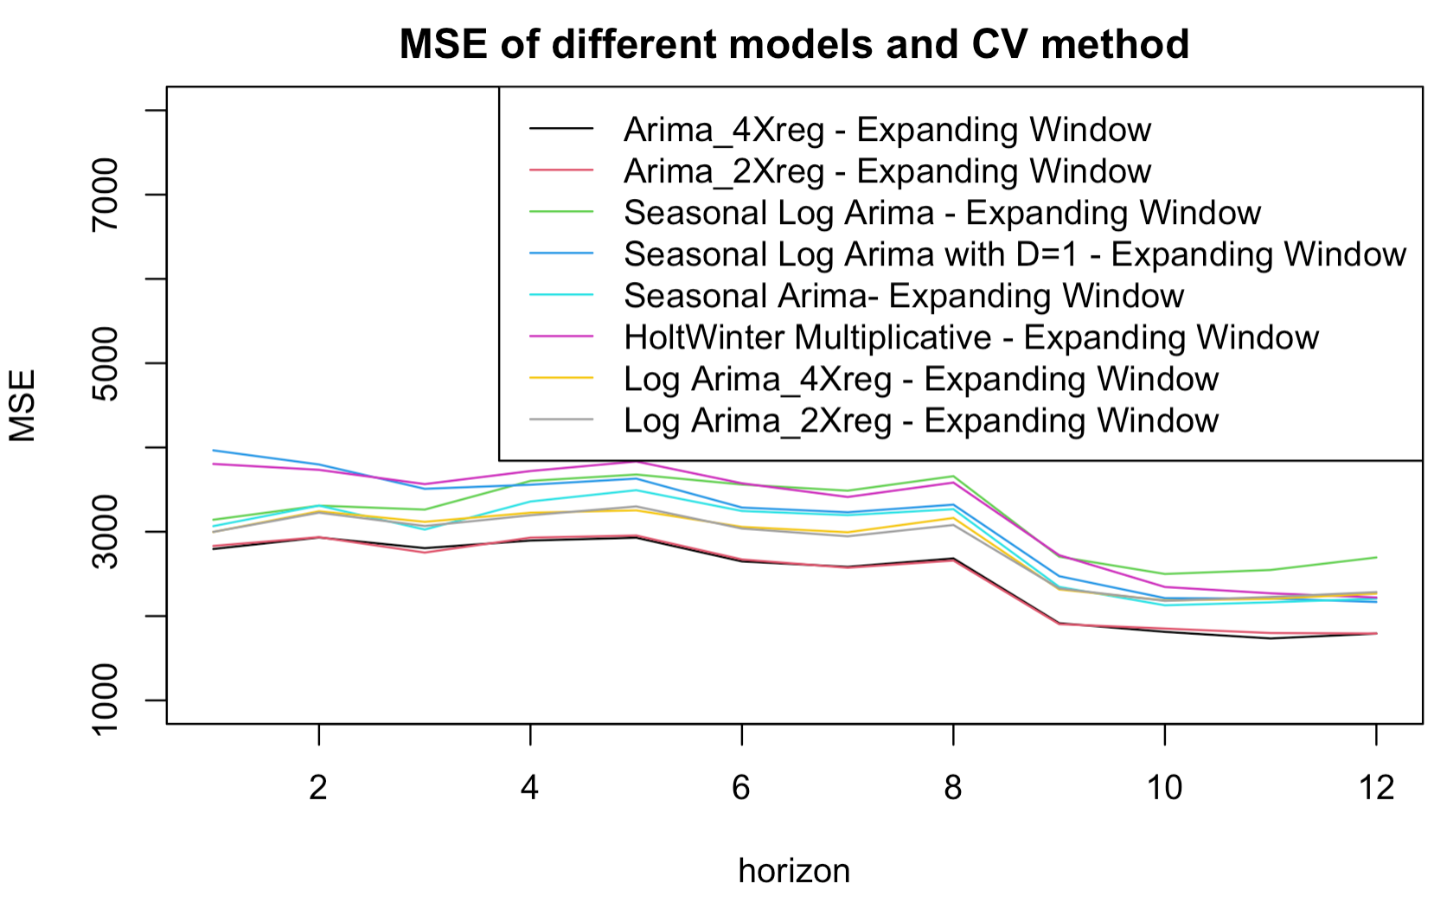
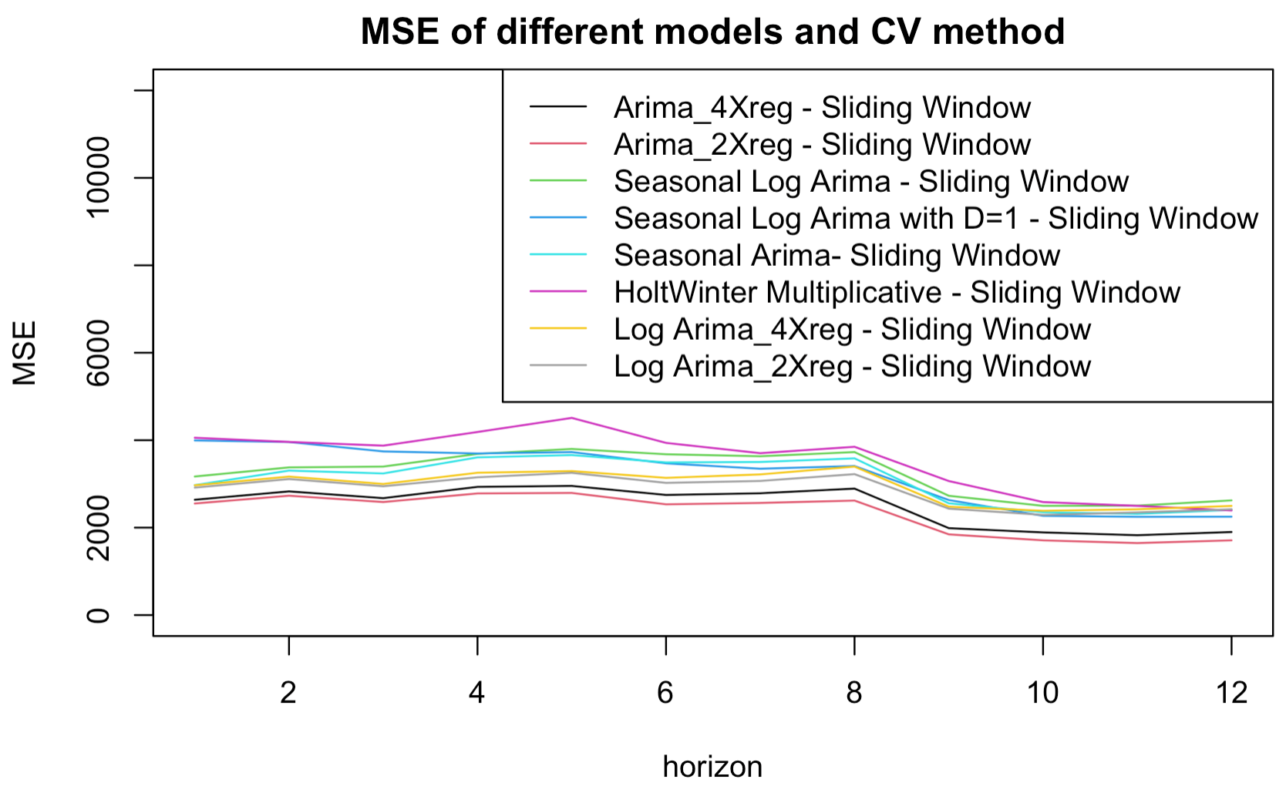
Appendix

Slide 24
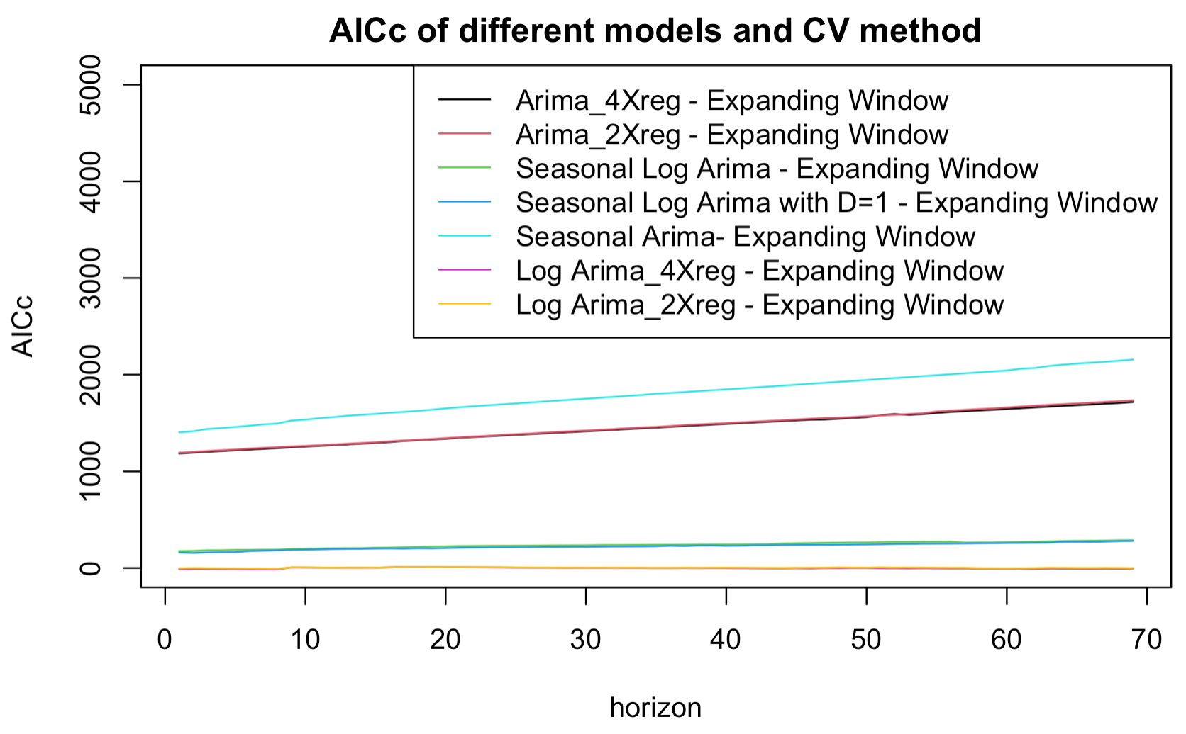
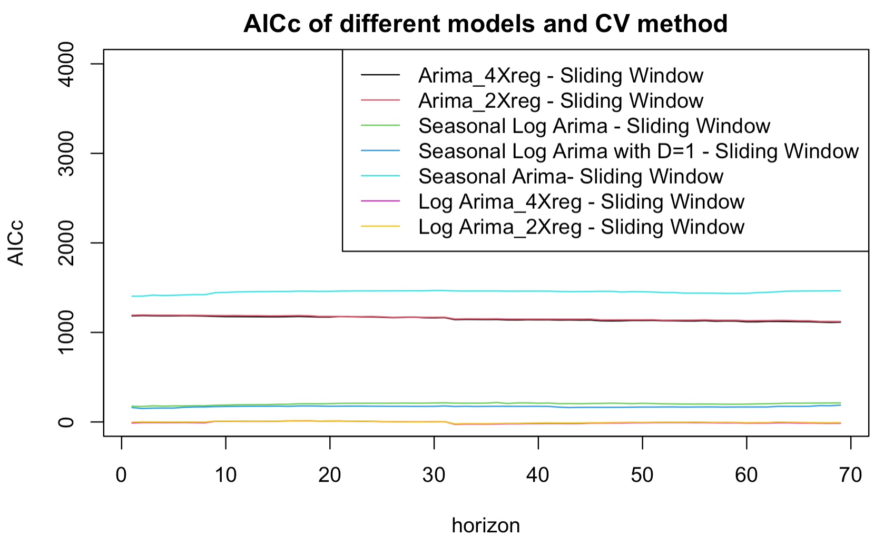
Appendix

